Slide 1

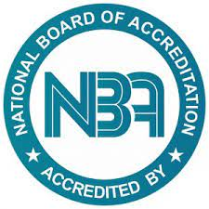
PANIMALAR ENGINEERING COLLEGE (An Autonomous Institution, Affiliated to Anna University) DEPARTMENT OF MECHANICAL ENGINEERING

Slide 2
About Us
An organization of the students, by the students and for the students

Slide 3
Energy Club Objectives
Energy clubs can have many objectives, including:
Energy conservation: Energy clubs can raise awareness about energy conservation and the need to use resources wisely.
Renewable energy: Energy clubs can work to increase the use of renewable energy sources.
Collaboration: Energy clubs can work with other organizations, academic divisions, and stakeholders to have a greater impact.

Slide 4
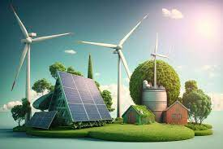
Sustainability: Energy clubs can focus on sustainability and reducing carbon emissions.
Innovation: Energy clubs can work on innovation in sustainable energy.
Water conservation: Energy clubs can work on water conservation and wastewater treatment.

Slide 5
Faculty Coordinators
Dr. N. POYYAMOZHI, Asst Prof/ Mech
Mr.P. SRIRAM, Asst Prof/ Mech

Slide 6
Student Coordinators
Chair – Rishi Madhan(III Year Mech)
Vice-Chair – S. Yogesh kumar(IV Year Mech)
Secretary – K. Lokesh (III Year Mech)
Joint Secretaries – D. Naveen Kumar(III Year Mech)

Slide 7
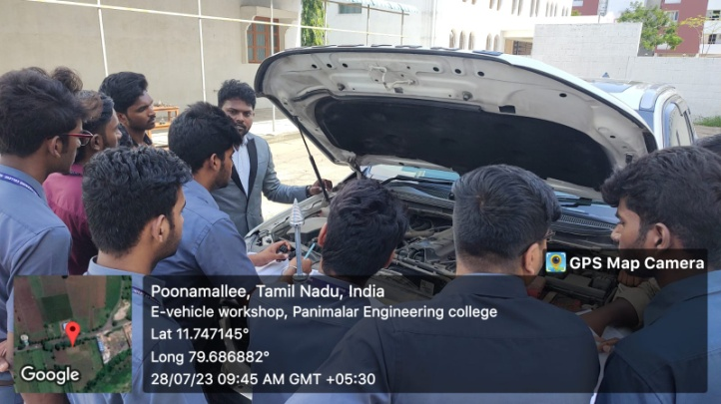
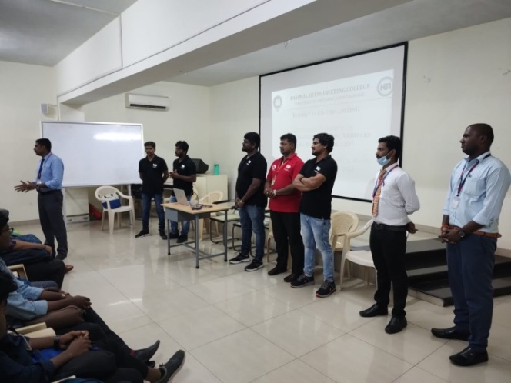
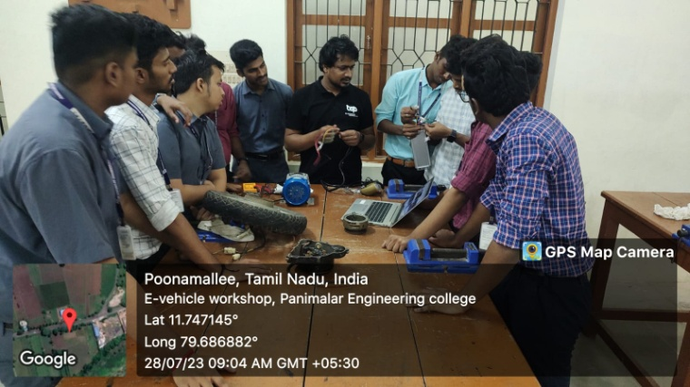
Activities
Workshops
Hands on Training
Guest Lectures
Seminars
Expert Talks

Slide 8
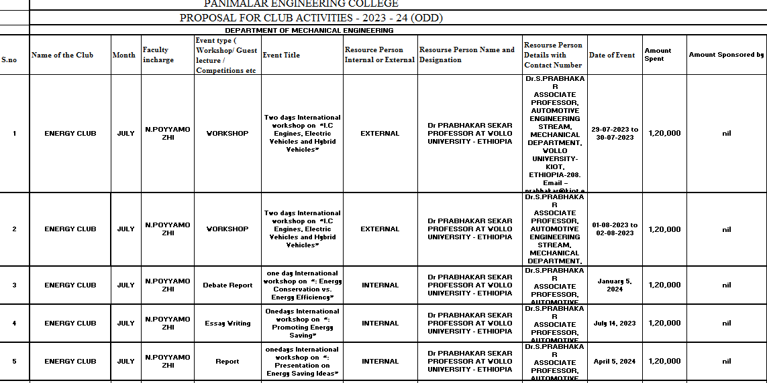
Club Activities Report:

